Slide 1
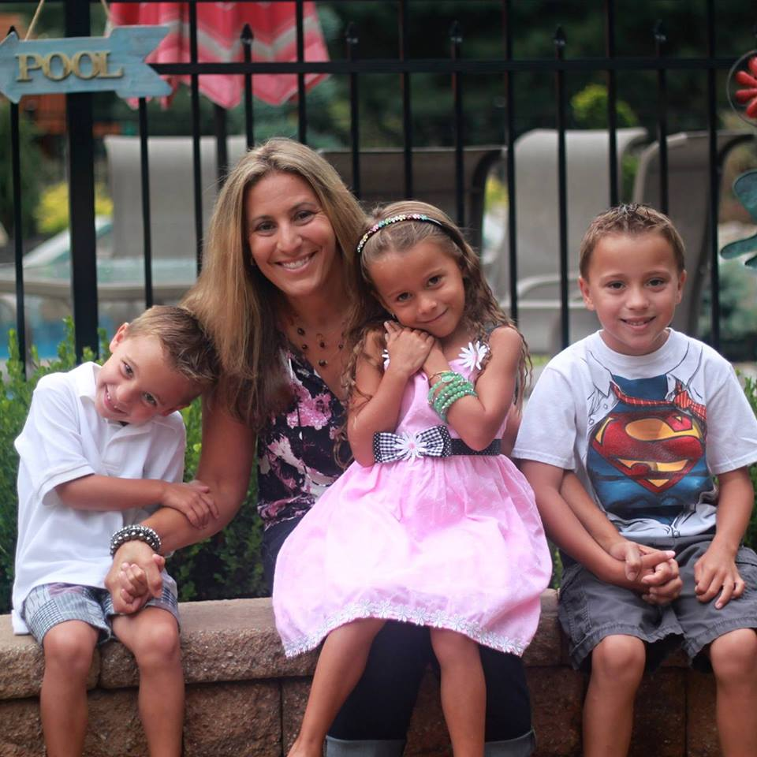
I have 3 kids…
Cooper, Summer and Hunter

Slide 2

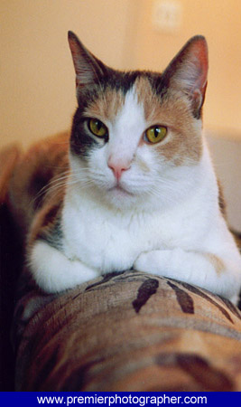
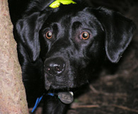
I have a cat named Jingles
and a dog named D.J

Slide 3



My favorite season is Summer

Slide 4




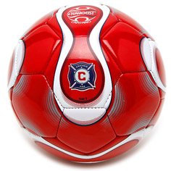



My favorite sport is Soccer

Slide 5
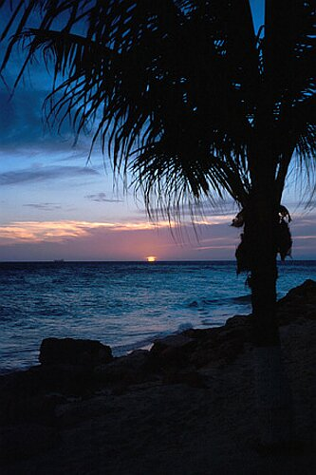
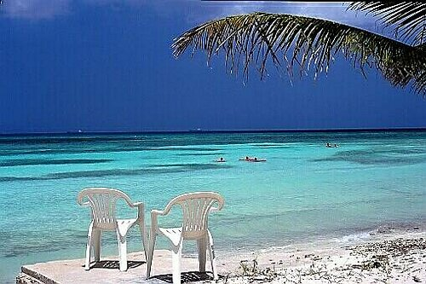

My favorite vacation spot
is Aruba

Slide 6


In my spare time I...
Go out to dinner
Go to the mall
Read
Hang out with my friends
Work out
Go to the movies

